Slide 1
Lecture 4

Slide 2
Plan of presentation
Python Iterators, Generators
Python Scope
Python Modules
Python Dates
Python Math
Python JSON

Slide 3
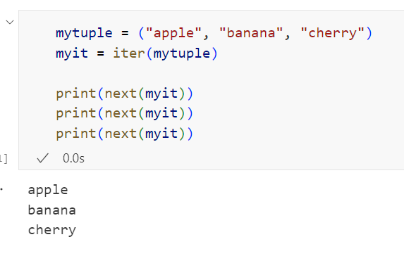
Iterators
Lists, tuples, dictionaries, and sets are all iterable objects. They are iterable containers which you can get an iterator from.
All these objects have a iter() method which is used to get an iterator:

Slide 4
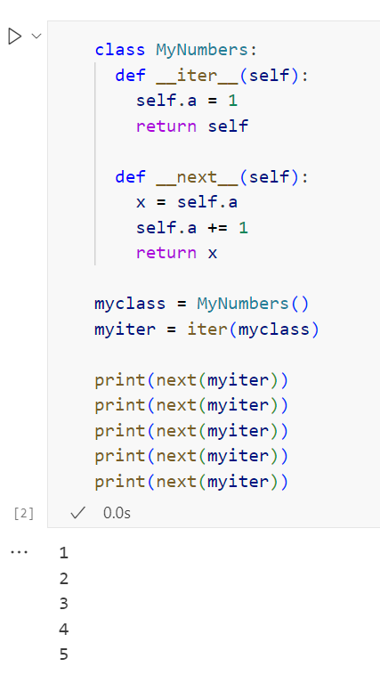
Iterators
To create an object/class as an iterator you have to implement the methods __iter__() and __next__() to your object.
As you have learned in the Python Classes/Objects chapter, all classes have a function called __init__(), which allows you to do some initializing when the object is being created.
The __iter__() method acts similar, you can do operations (initializing etc.), but must always return the iterator object itself.
The __next__() method also allows you to do operations, and must return the next item in the sequence.

Slide 5
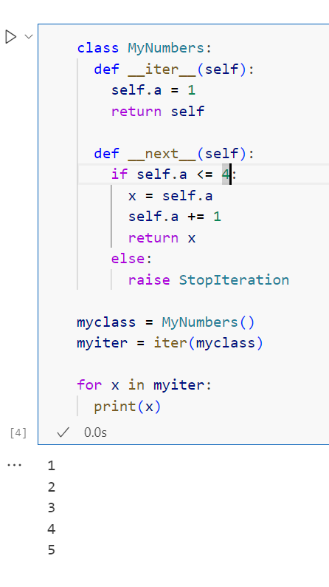
Iterators
The example above would continue forever if you had enough next() statements, or if it was used in a for loop.
To prevent the iteration from going on forever, we can use the StopIteration statement.
In the __next__() method, we can add a terminating condition to raise an error if the iteration is done a specified number of times:

Slide 6
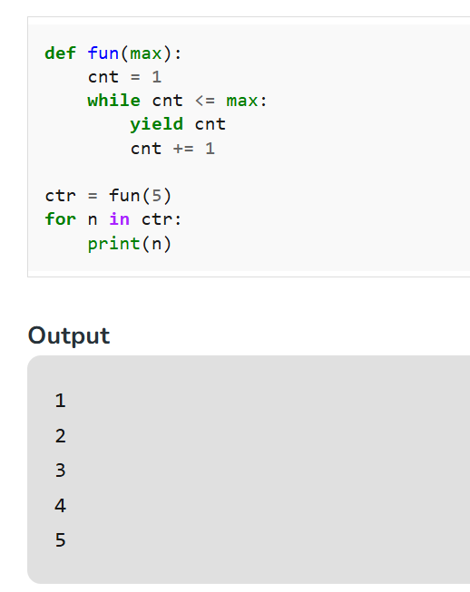
Generators
A generator function is a special type of function that returns an iterator object. Instead of using return to send back a single value, generator functions use yield to produce a series of results over time. This allows the function to generate values and pause its execution after each yield, maintaining its state between iterations.

Slide 7
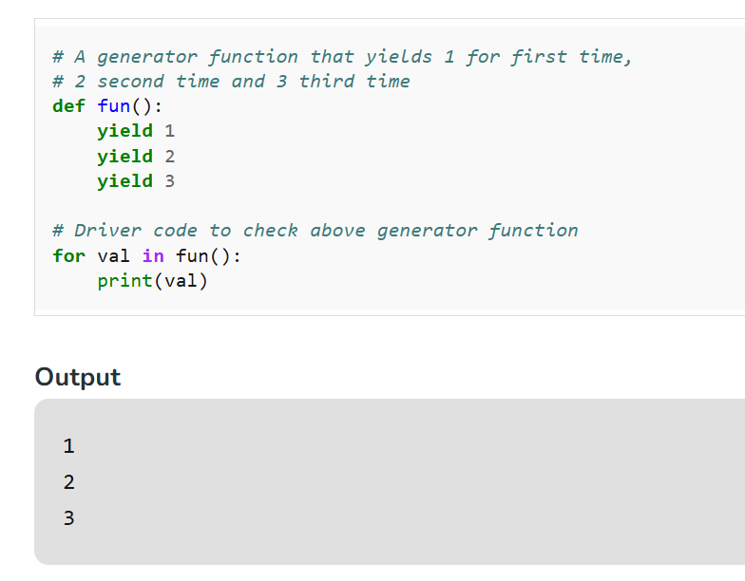
Generators
Creating a generator in Python is as simple as defining a function with at least one yield statement. When called, this function doesn’t return a single value; instead, it returns a generator object that supports the iterator protocol.

Slide 8
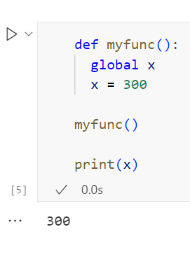
Scope
If you need to create a global variable, but are stuck in the local scope, you can use the global keyword.
The global keyword makes the variable global.

Slide 9
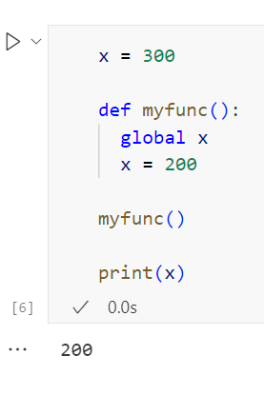
Scope
To change the value of a global variable inside a function, refer to the variable by using the global keyword:

Slide 10
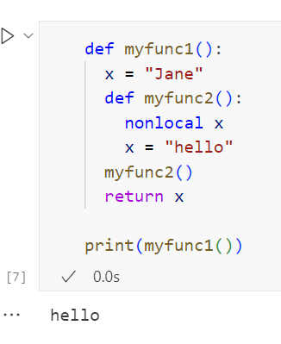
Scope
The nonlocal keyword is used to work with variables inside nested functions.
The nonlocal keyword makes the variable belong to the outer function.

Slide 11
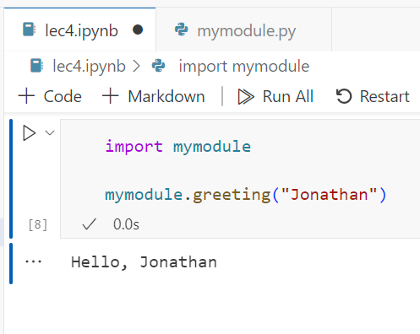
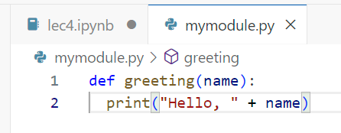
Module
To create a module just save the code you want in a file with the file extension .py:

Slide 12
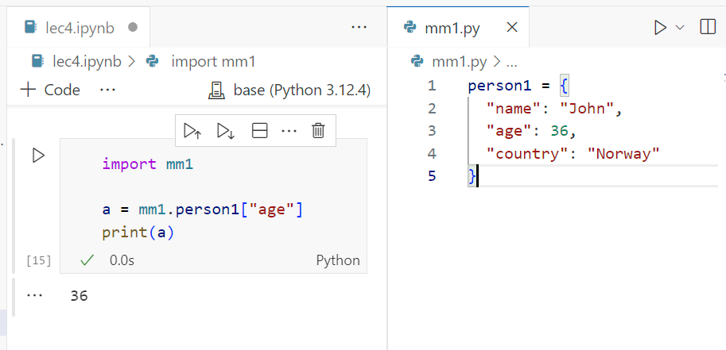
Module
The module can contain functions, as already described, but also variables of all types (arrays, dictionaries, objects etc):

Slide 13
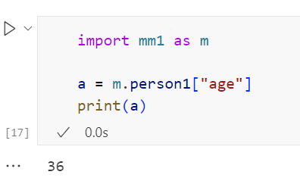
Renaming a module
You can create an alias when you import a module, by using the as keyword

Slide 14
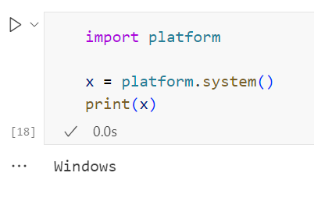
Built in modules
There are several built-in modules in Python, which you can import whenever you like.

Slide 15
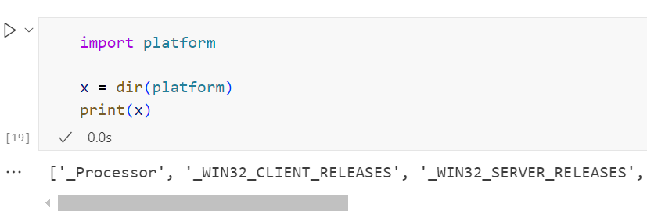
Using the dir() Function
There is a built-in function to list all the function names (or variable names) in a module. The dir() function

Slide 16
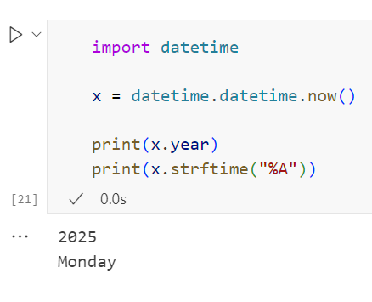
Datetime
A date in Python is not a data type of its own, but we can import a module named datetime to work with dates as date objects.

Slide 17
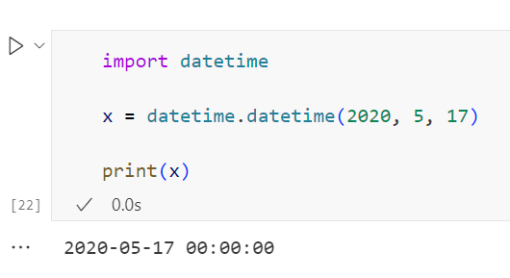
Datetime
To create a date, we can use the datetime() class (constructor) of the datetime module.
The datetime() class requires three parameters to create a date: year, month, day.

Slide 18
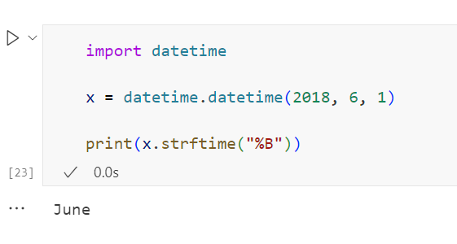
Datetime
The datetime object has a method for formatting date objects into readable strings.
The method is called strftime(), and takes one parameter, format, to specify the format of the returned string:

Slide 19
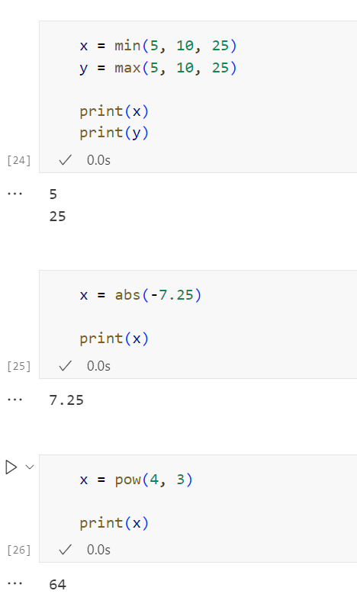
Python math
The min() and max() functions can be used to find the lowest or highest value in an iterable
The abs() function returns the absolute (positive) value of the specified number
The pow(x, y) function returns the value of x to the power of y (xy)

Slide 20
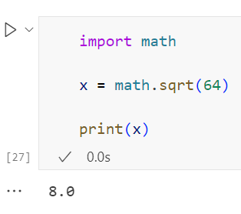
Python math
Python has also a built-in module called math, which extends the list of mathematical functions.
The math.sqrt() method for example, returns the square root of a number

Slide 21
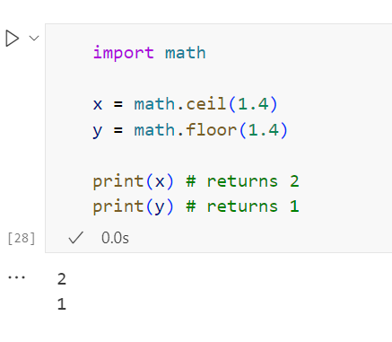
Python math
The math.ceil() method rounds a number upwards to its nearest integer, and the math.floor() method rounds a number downwards to its nearest integer, and returns the result

Slide 22
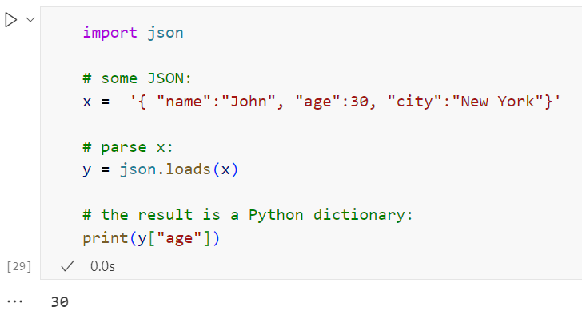
JSON
Python has a built-in package called json, which can be used to work with JSON data.
JSON is text, written with JavaScript object notation.
If you have a JSON string, you can parse it by using the json.loads() method.

Slide 23
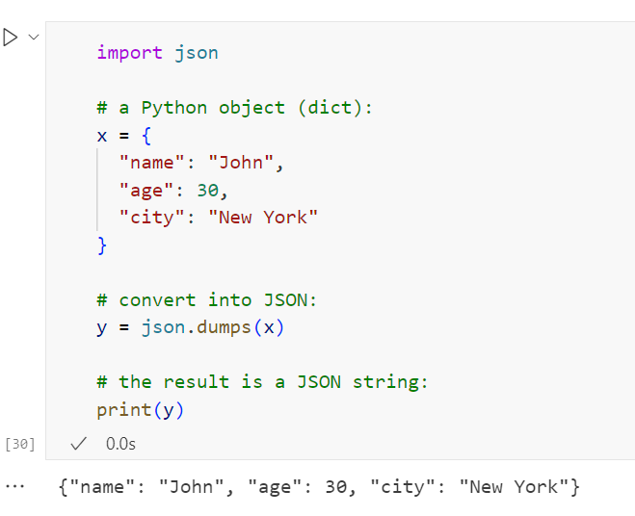
JSON
If you have a Python object, you can convert it into a JSON string by using the json.dumps() method.

Slide 24
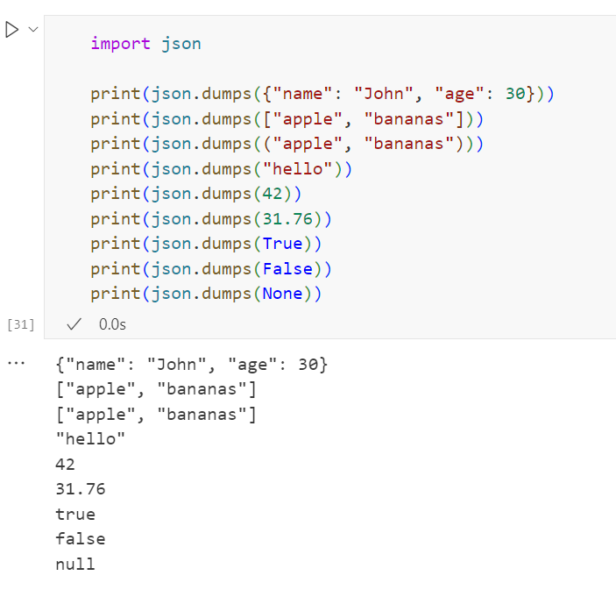
JSON
You can convert Python objects of the following types, into JSON strings:
dict
list
tuple
string
int
float
True
False
None

Slide 25
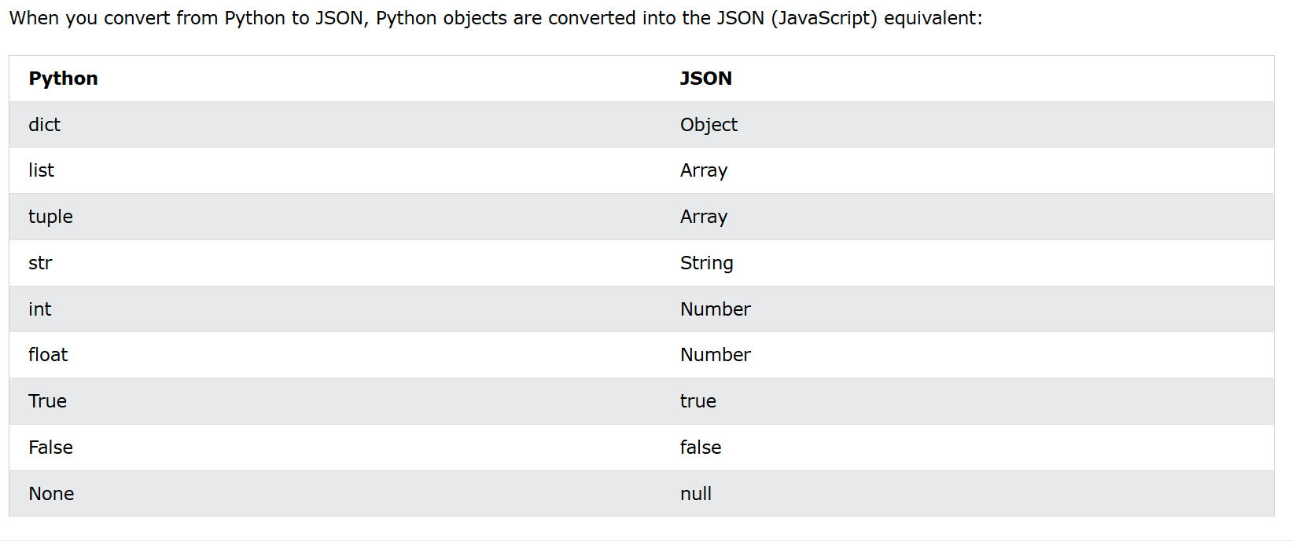
JSON

Slide 26
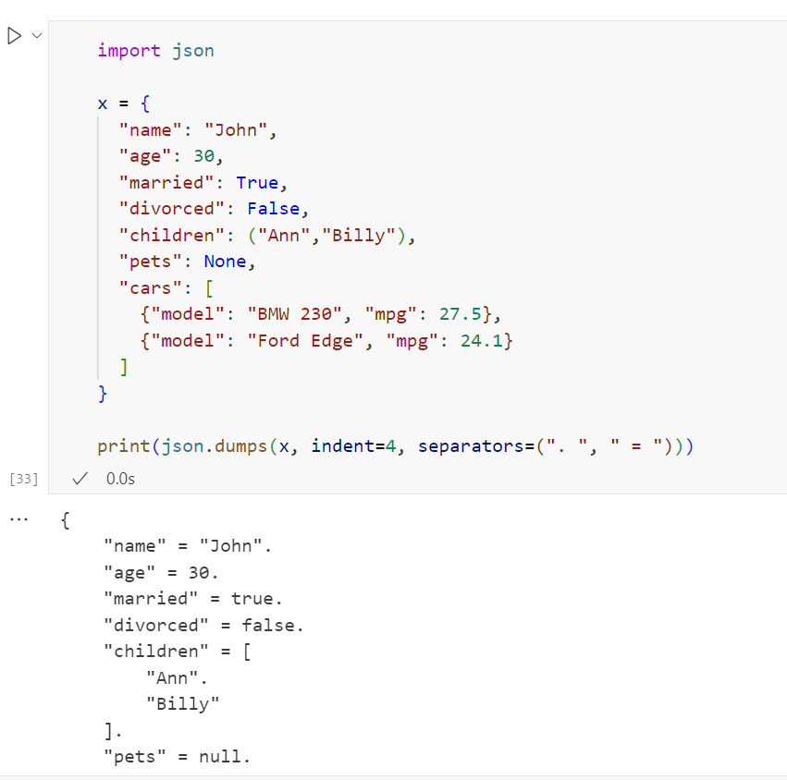
JSON
You can also define the separators, default value is (", ", ": "), which means using a comma and a space to separate each object, and a colon and a space to separate keys from values:

Slide 27
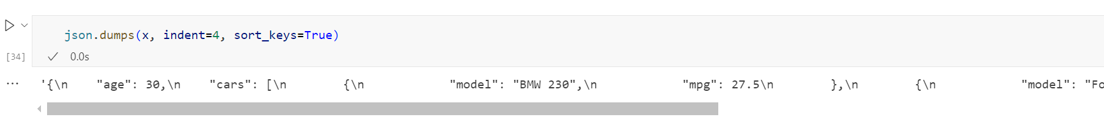
JSON
The json.dumps() method has parameters to order the keys in the result

Slide 28
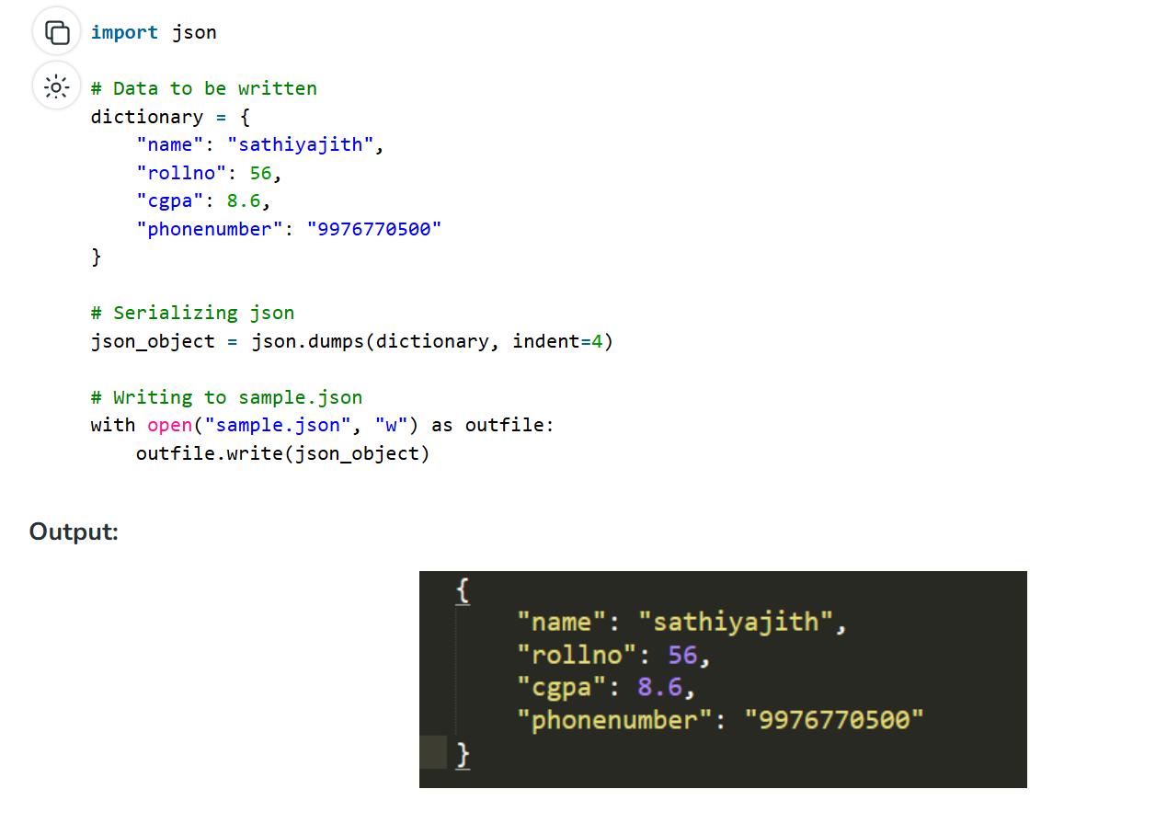
JSON
The JSON package in Python has a function called json.dumps() that helps in converting a dictionary to a JSON object. It takes two parameters:
dictionary – the name of a dictionary which should be converted to a JSON object.
indent – defines the number of units for indentation

Slide 29
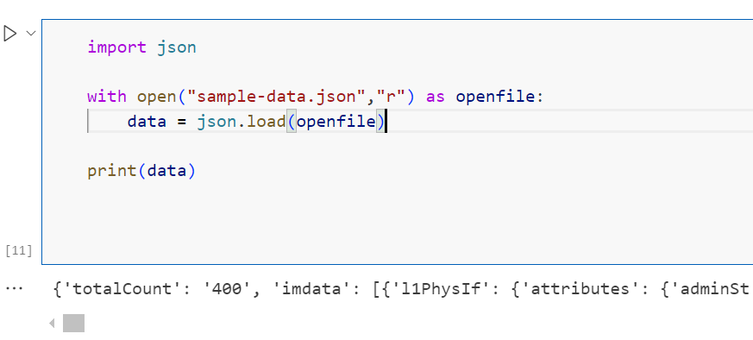
JSON
The JSON package has json.load() function that loads the JSON content from a JSON file into a dictionary. It takes one parameter:
File pointer: A file pointer that points to a JSON file.

